Slide 1
Profiles of Everyday Executive Function with the Behavior Rating of Executive Function, Second Edition (BRIEF2)
Presented by Jennifer Greene, MSPH
Melissa Messer, Peter K. Isquith, Gerard A. Gioia, Lauren Kenworthy & Steven C. Guy
Disclosure: Presenters are affiliated with PAR

Slide 2
Background
The Behavior Rating of Executive Function, Second Edition (BRIEF2) are rating scales designed to measure executive function in children ages five to 18.
Parent, teacher, and self-report forms are available.

Slide 3
Objective
We examined profiles of everyday executive function in children with different developmental disorders on the BRIEF2.

Slide 4
Instrument
Parent Form: 63 items; Teacher Form: 63 items; Self-Report Form: 58 items
Each item asks the parent to rate how often the child has experienced the behavior in the past six months, on a scale of Never (1), Sometimes (2) or Often (3).

Slide 5
Instrument (con’t.)
Measures nine clinical scales grouped into three indexes (Behavior Regulation, Emotion Regulation, Cognitive Regulation)
All scales are also grouped into one overall composite, the Global Executive Composite (GEC).

Slide 6
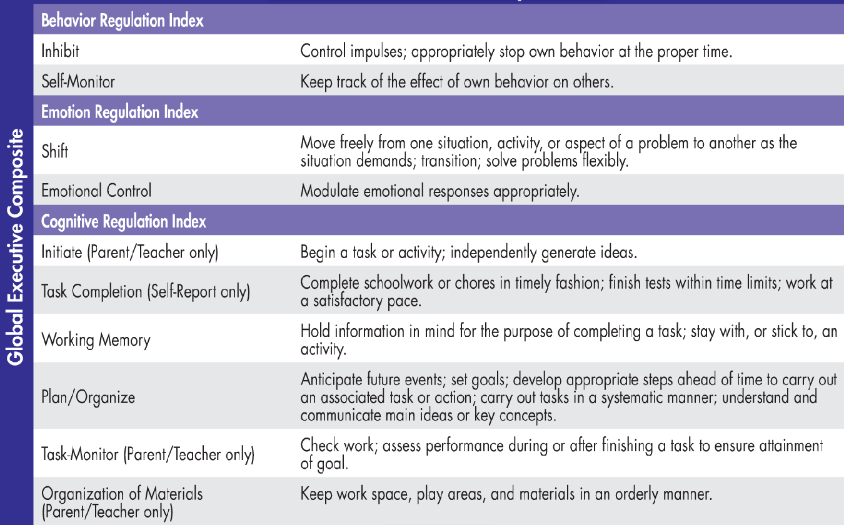
Scale/Indexes

Slide 7
Participants
Sample | Parent | Teacher | Self-Report
ADHD-Combined presentation (ADHD-C) | 218 | 110 | 22
ADHD-Inattentive presentation (ADHD-I) | 159 | 113 | 71
Autism Spectrum Disorder (ASD) | 262 | 106 | 22
Learning Disability (LD) | 113 | 100 | 27
Gender/age matched typically developing children (TD) | 752 | 429 | 142
Diverse samples identified on comprehensive clinical assessment
Matched with typically developing children from the BRIEF2 standardization sample

Slide 8
Method
Three separate mixed-model ANOVAs, one for each of the three BRIEF2 forms.
Scores on each scale were treated as within-subjects variables
Diagnostic group (TD, ADHD-C, ADHD-I, ASD, LD) was treated as the between-subjects variable.

Slide 9
Results
All main effects and interactions were significant (p < .001) for each of the Parent, Teacher, and Self-Report forms.
Clinical groups differed in terms of overall level, with some groups being rated as having much greater executive function difficulties overall than others.
Clinical groups also had different profiles of elevations, or peaks and valleys, on the scales.

Slide 10
Overall Profiles
Most groups were similarly elevated on the Working Memory, Plan Organize, and Task-Monitor scales
with the exception of the LD group which had more modest elevations.
Parent and Teacher ratings were similar. The highest elevation for all clinical groups on the Self-Report Form was on the Task Completion scale.

Slide 11
LD: Modest Cognitive Regulation Elevations

Slide 12
ADHD-I: Cognitive Regulation Elevations

Slide 13
ADHD-C: Peak on Inhibit Scale

Slide 14
ASD: Peak on Shift Scale

Slide 15
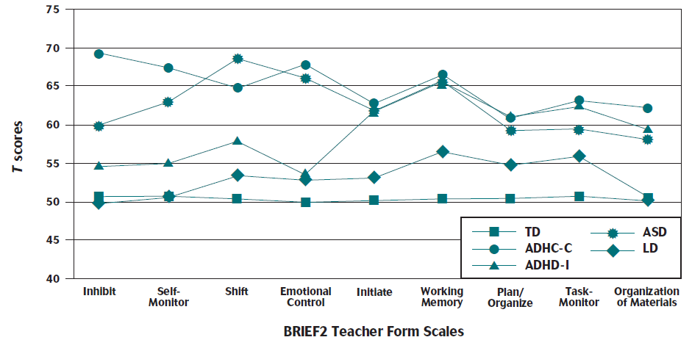
Teacher Profiles
Teacher ratings show similar profiles
Notes:
LD: Modest cog regulation elevations
ADHD-I: Cog regulation elevations
ADHD-C: Peak on Inhibit scale
ASD: Peak on Shift Scale

Slide 16
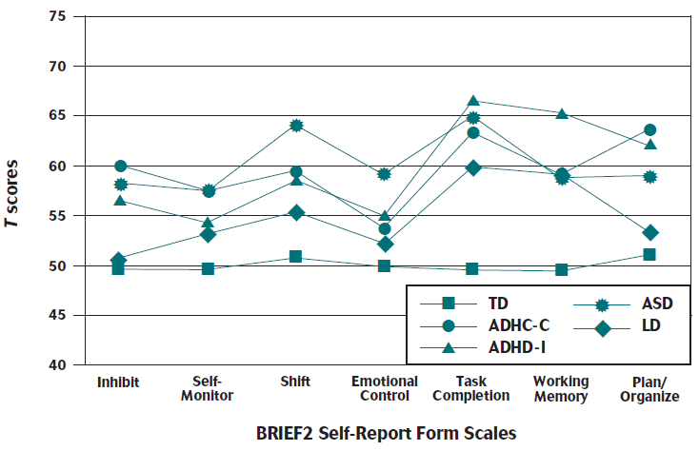
Self-Report Profiles
Self-report ratings less differentiated but similar profiles
Notes:
LD: Modest cog regulation elevations
ADHD-I: Cog regulation elevations
ADHD-C: Peak on Inhibit scale
ASD: Peak on Shift Scale

Slide 17
Conclusions
Findings are consistent with the notion that different diagnostic groups may have characteristic profiles of executive function strengths and weaknesses.
That these are measurable on the BRIEF2 contributes to the body of evidence for valid interpretation of BRIEF2 scores in children with a wide range of disorders.

Slide 18
Questions?

